Slide 1
Classification of Lung CT Scans
Hanlin Zou, Landon Kushimi, Kaiyang Zhao
Notes:
Hanlin

Slide 2
Problem and Background
COVID-19 continues to ravage low income and underdeveloped parts of the world
Limitations of traditional RT-PCR testing
Can we overcome these limitations with ML techniques?
Notes:
Landon

Slide 3
Tasks
Task 1: Classify whether a person is Covid patient or not
Task 2: Classify a person is healthy, Covid or Pneumonia
Notes:
Hanlin

Slide 4
Dataset info
6893 lung CT scans from 604 healthy people
7593 lung CT scans from 466 Covid-19 patients
2618 lung CT scans from 60 Pneumonia patients
Notes:
Hanlin

Slide 5
Plan
Task 1 Demo ONE model:
Training: 80 Normal + 80 Covid
Validation: 20 Normal + 20 Covid
Testing: 30 Normal + 30 Covid
50 epochs
Task 2 Demo TWO models:
Training: 80 Normal + 80 Covid + 80 Pneumonia
Validation: 20 Normal + 20 Covid + 20 Pneumonia
Testing: 30 Normal + 30 Covid + 30 Pneumonia
100 epochs
Then run the models on full data set on SCC
Notes:
Hanlin

Slide 6
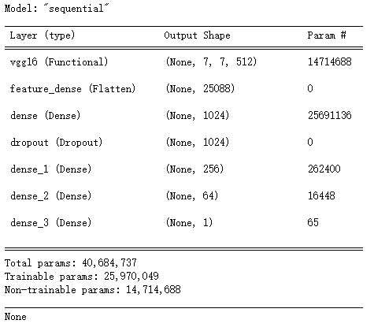
Task 1 Model: VGG16
Pre-trained VGG16 as backbone
Flatten layer
Fully-connected layer(1024 neurons)
Drop out w/ rate 0.5
Fully-connected layer(256 neurons)
Fully-connected layer(64 neurons)
Output layer(Sigmoid)
Adam as optimizer
binary cross-entropy loss function
50 Epochs w/ learning rate 0.0005
Notes:
Hanlin

Slide 7
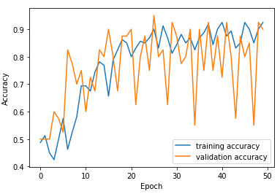
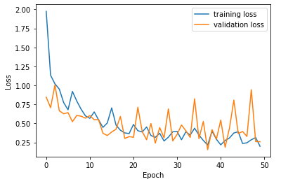
Task 1 Demo Training Accuracy & Training Loss
Notes:
Tommy

Slide 8
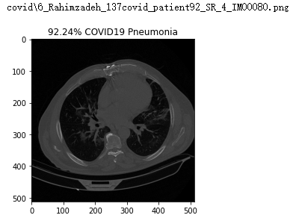
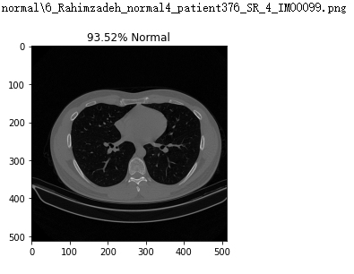
Task 1 Demo Test results
Notes:
Tommy

Slide 9
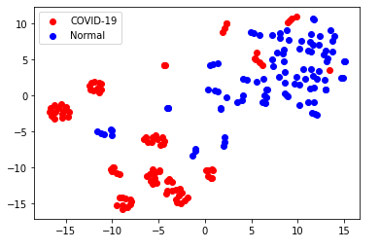
Task 1 Demo TSNE Plot
Notes:
Tommy

Slide 10
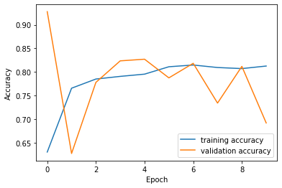
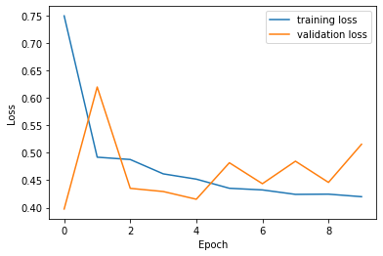
Task 1 All Data Training Accuracy and Loss
Notes:
*Only 10 epochs due to time* Landon

Slide 11
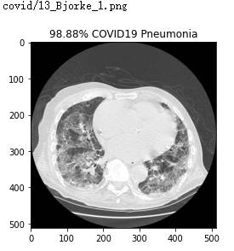
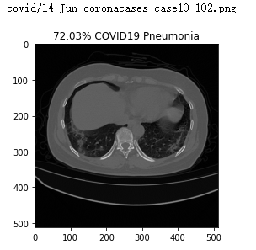
Task 1 All Data Test Results
Notes:
Landon

Slide 12
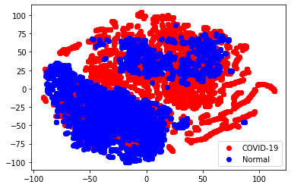
Task 1 All Data TSNE Plot
Notes:
Landon

Slide 13
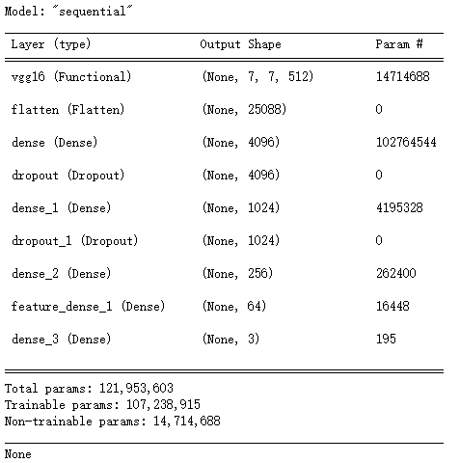
Task 2 Model 1: VGG16
Pre-trained VGG16 as backbone
Flatten layer
Fully-connected layer(4096 neurons)
Drop out w/ rate 0.5
Fully-connected layer(1024 neurons)
Drop out w/ rate 0.5
Fully-connected layer(256 neurons)
Fully-connected layer(64 neurons)
Output layer(Softmax)
Adam as optimizer
categorical cross-entropy loss function
100 Epochs w/ learning rate 0.00001
Notes:
Hanlin

Slide 14
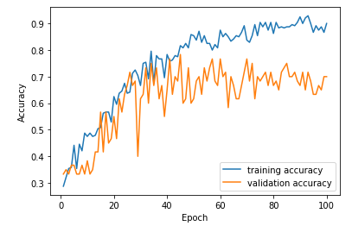
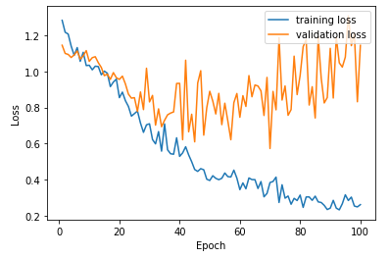
Task 2 Model 1 Demo Training Accuracy & Training Loss
Notes:
Tommy

Slide 15

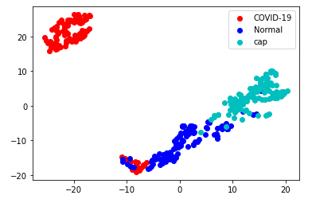
Task 2 Model 1 Demo Test results & TSNE Plot
Notes:
Tommy

Slide 16

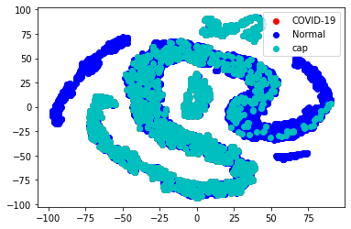
Task 2 Model 1 All Data
Notes:
not great lol needed more epochs/more time to train
Landon

Slide 17
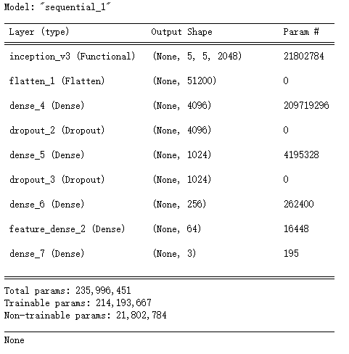
Task 2 Model 2: Inception V3
Pre-trained Inception V3 as backbone
Flatten layer
Fully-connected layer(4096 neurons)
Drop out w/ rate 0.5
Fully-connected layer(1024 neurons)
Drop out w/ rate 0.5
Fully-connected layer(256 neurons)
Fully-connected layer(64 neurons)
Output layer(Softmax)
Adam as optimizer
categorical cross-entropy loss function
100 Epochs w/ learning rate 0.00001
Notes:
Hanlin

Slide 18
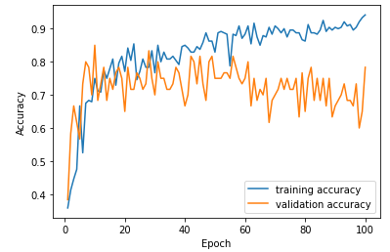
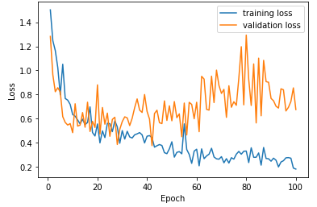
Task 2 Model 2 Demo Training Accuracy & Training Loss
Notes:
Tommy

Slide 19
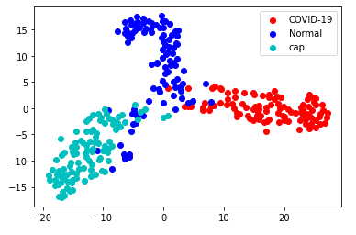
Task 2 Model 2 Demo Test results & TSNE Plot
Notes:
Tommy

Slide 20
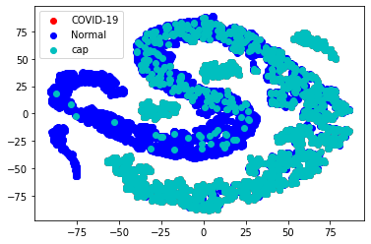
Task 2 Model 2 All Data
Notes:
lol also not great, Landon

Slide 21
Conclusion
Binary Classification: VGG16, 100% accuracy
Multi- Class Classification:
VGG16, 71.67%
InceptionV3, 100%
Future Directions
Testing with full dataset
Quantify severity of disease
Notes:
Landon

Slide 22
Thank You
Questions?

